Slide 1

Auto-reporting tools

Slide 2

Agenda
Opening remarks and agenda adoption;
Quick recap on the work done so far and next steps;
Draft plan for the first meeting (Paris, 1–4 December);
Use cases work in parallel to themes/WGs
3 selected presentations on themes proposals (more in the next meetings)
Next milestones, next meetings and proposed cadence;
AOB and agreement on next steps.

Slide 3
Why creating TIDA?
As AI agents begin to negotiate, transact, and act autonomously on our behalf, the world lacks common international foundations to establish who these agents are, when they can be trusted, and how humans remain in control: FG-TIDA was created to build that foundation before agentic AI becomes ubiquitous
Our objective is to define architectural models and interoperability frameworks that establish trust in agentic AI.
As part of the UN, we bring together an inclusive, global community of Member States, academia, and industry to build this foundation together.

Slide 4
What is a Focus Group in ITU?
TIDA Focus Group is
An Open Community (no need to be member of ITU to participate)
conducting pre-standardization work

Slide 5
Pls subscribe to our Mailing List
Please subscribe to the mailing list here:
https://www.itu.int/en/ITU-T/focusgroups/tida/Pages/default.aspx
→ From Dec 1st I will ONLY use the mailing list to send meeting invitations

Slide 6

Engage in our GitHub space!
TIDA · GitHub
Notes:
Open the Terms of Reference

Slide 7
What is happening next?
7 Sep 2026
2nd SG17 Content Week, Chongqing (China)
Two SG17 workshops: ITS/CAV security · Secure Agentic AI
7 Oct 2026
Interim SG17 plenary (virtual)
Progress checkpoint
1–4 Dec 2026
FG-TIDA 1st meeting, Paris
With the Digital Trust Convention at the OECD on 4 December
9 Dec 2026
Interim SG17 plenary (virtual)
Progress checkpoint
25* Jan 2027
SG17 workshop, Geneva
Open to all participants
26 Jan 2027
FG-TIDA meeting, Geneva
Focus Group working session
18–29* Jan 2027
6th SG17 Plenary, Geneva
Next full plenary

Slide 8
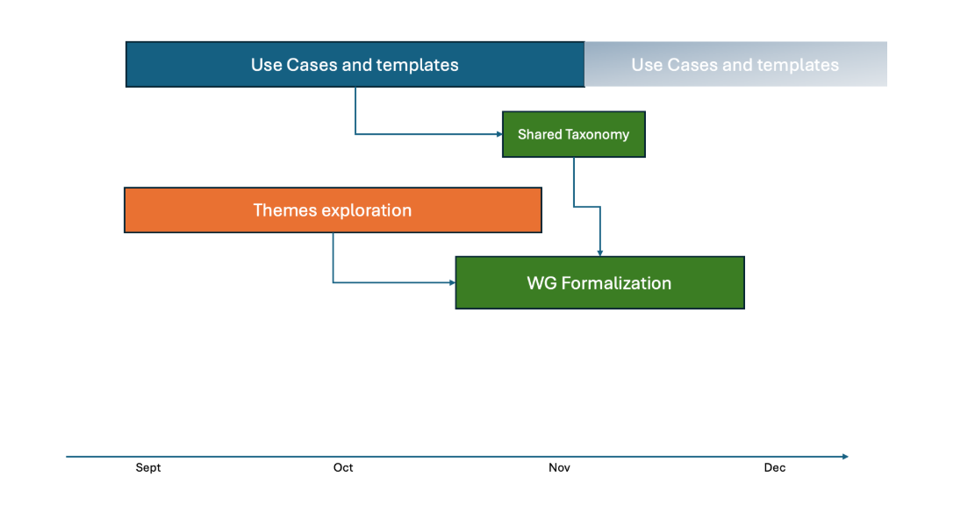
Our timeline for 2026
Notes:
Open the Terms of Reference

Slide 9
Our Objective for 1-4 Dec meeting
Formally announce the Focus Group's structure and leadership
Publish an initial definition of deliverables on GitHub
Advance the technical work during the in-person meeting
Notes:
Approach bottom up → what we need from you

Slide 10
How to get there? 5 virtual meetings from now to 1-4 Dec
29th of July @2pm CET
(today) 2nd of September @2pm CET
30th of September @2pm CET
NEW! 14th of October @2.30pm CET
4th of November @2pm CET
Notes:
Approach bottom up → what we need from you

Slide 11
Current TIDA Structure

Slide 12
Introduction to the Use Cases work
Notes:
Which prez from workshops to add as reference?
Contributions are driven by the community
Technical Development rather than policy work. We are in a position of solution architect even if not everything is done by SG17.

Slide 13
Let us brainstorm together on ideas for Working Groups
Notes:
Which prez from workshops to add as reference?
Contributions are driven by the community
Technical Development rather than policy work. We are in a position of solution architect even if not everything is done by SG17.

Slide 14
Selected presentations on proposed themes
Theme #4. Access Control and Security Policy Enforcement with Metamorophing AI Agents
Theme #6. Intent-based security policies: expression, coexistence, and runtime verification
Theme TBD. Remote Attestation for Agentic AI
Notes:
Approach bottom up → what we need from you

Slide 15
THANK YOU FOR YOUR PARTICIPATION

